Slide 1




Cumulative-time Signal Temporal Logic
Hongkai Chen¹, Zeyu Zhang², Shouvik Roy³, Ezio Bartocci⁴, Scott A. Smolka²,
Scott Stoller², Shan Lin²
¹ The Chinese University of Hong Kong, Hong Kong
² Stony Brook University, USA
³ Illinois Institute of Technology, Chicago
⁴ TU Wien, Austria

Slide 2

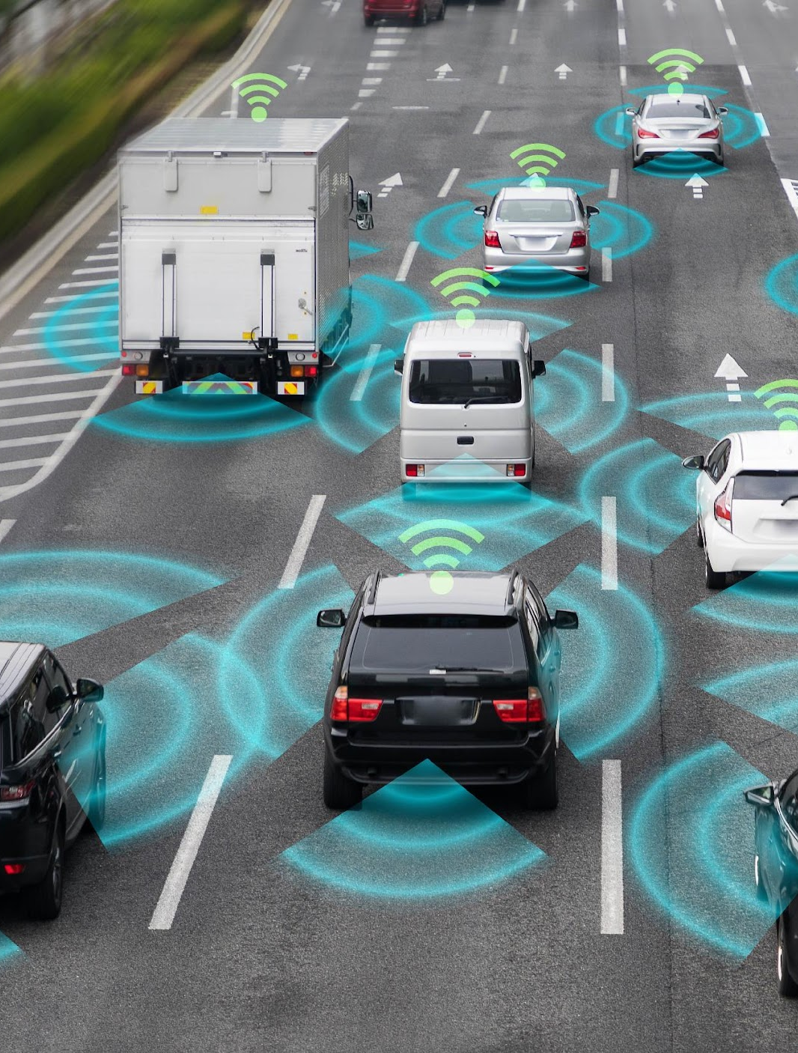


Cyber-Physical Systems (CPSs)
smart grid, autonomous automobile systems, medical imaging, microprocessors…

Slide 3
The Need for Cumulative-Time Reasoning in CPSs
CPSs require formal specification languages for
  expressing, monitoring, and ensuring properties of…
  reliability, security, safety, liveness…
Signal Temporal Logic (STL) is widely used but lacks the ability to express cumulative temporal properties
  i.e., aggregated duration of events over intervals.
  applications where accumulated sustained compliance, rather than momentary satisfaction of requirements, determines system safety or efficiency.
Notes:
In these CPSs, we often need formal spec languages for… STL is widely used for these purposes, however, there is one thing stl cannot do, that is the cumulative-time reasoning.. It means the ability to express…. This is particularly important in

Slide 4
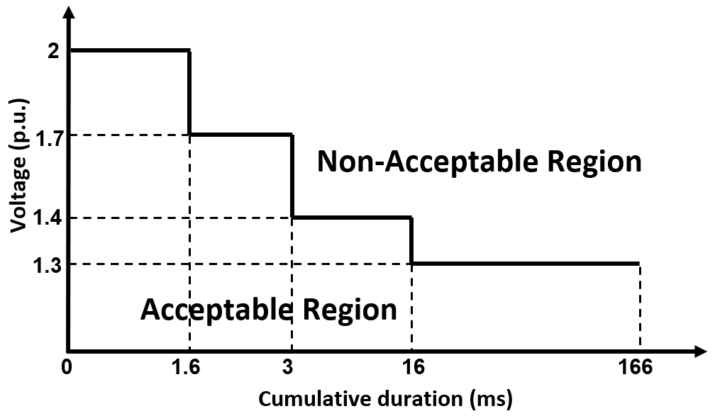
The Need for Cumulative-Time Reasoning in CPSs
* Figure from IEEE Standard 1547-2018
Power quality criteria and requirements for interconnection of DERs with electric power systems (EPSs):
Cumulative duration of instantaneous over-voltage remains within strict limits over a time window
Notes:
Let look at an example from the IEEE standard 15 47 -2018, It specifies…. Long story short, it says the cumulative duration …..

Slide 5

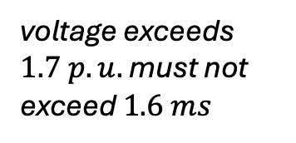
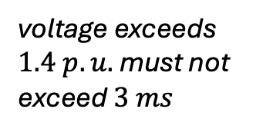
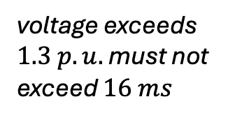
The Need for Cumulative-Time Reasoning in CPSs
* Figure from IEEE Standard 1547-2018
Notes:
Specifically, the upper bound of the acceptable region

Slide 6
The Need for Cumulative-Time Reasoning in CPSs
* Figure from IEEE Standard 1547-2018
How can we specify cumulative-time requirements?
How can we decide the satisfaction/violation and the extent of such satisfaction/violation?
How can we monitor these requirements online?
Notes:
Let look at an example from the IEEE standard 15 47 -2018, It specifies…. Long story short, it says the cumulative duration …..

Slide 7
Related Work
Signal Temporal Logic (STL)
  [Maler04] a dense-time temporal logic that extends a fragment of MITL
  However, classical syntax and semantics of STL cannot evaluate cumulative temporal properties over time
At the semantic level
  Replacing the Boolean semiring with alternative algebraic structures
  Proposed smooth cumulative robustness for control (e.g., [Haghighi19]), or accumulative robustness metric for STL (e.g., ASTL [Zhao22])
  Impose limitation of the original STL syntax or require special monitoring frameworks
At the syntax level
  AvSTL with averaged temporal operators [Takumi15]
  Signal Convolution Logic (SCL) replaces the temporal operators with convolution operators [Silvetti18]
  Average with respect to the time interval or cannot work with certain temporal operators
In contrast, we propose…
  temporal operator at the level of STL syntax, strictly more expressive than STL
  robustness that provides the largest perturbation allowed to preserved the cumulative-time requirements
Notes:
One might wonder, these seems like common. Do we already have temporal logic to do express that? As we mentioned, although STL is powerful, it cannot specify such requirements. At the semantics level, people tried to … and proposed … or … However, they usually … At the syntax level, averaged temporal operators and convolution operators are proposed but those operators …. In contrast, we propose..

Slide 8
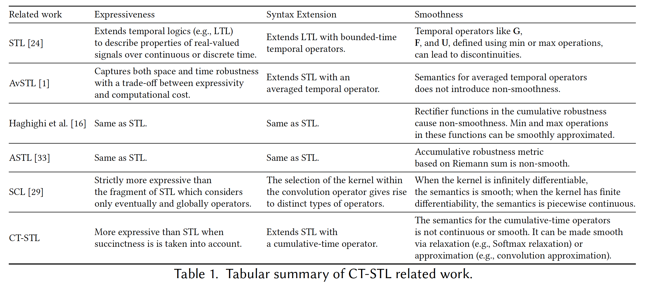
Related Work
Notes:
This is a more elaborate comparison with other languages in terms of expressiveness, syntax extension, and smoothness

Slide 9
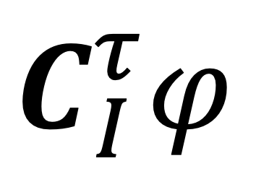
Our Contributions
A new temporal logic called CT-STL
  extends the STL syntax with a new cumulative-time operator
  sums all of the time durations for which its nested formula φ is satisfied over an interval I and compares the result with a threshold of time τ
Provide qualitative and quantitative semantics (robustness)
Prove soundness and completeness of the new quantitative semantics
Provide an online monitoring algorithm for CT-STL
The utility of our logic and the monitoring algorithm on two case studies
Notes:
So this is the summary of our contributions.

Slide 10
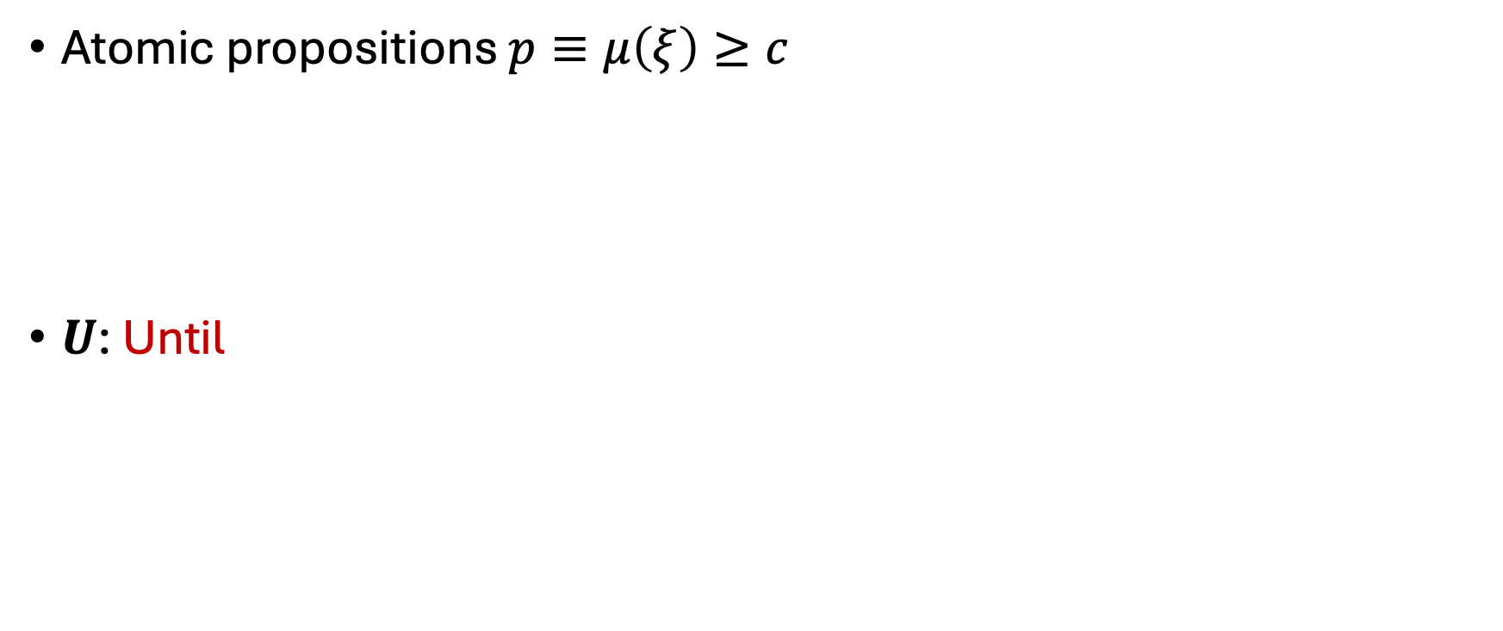
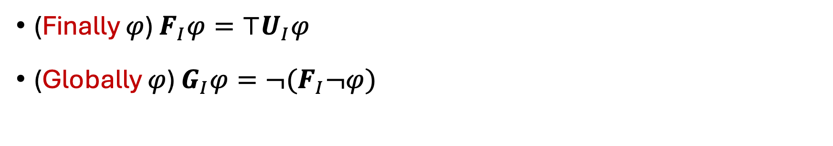
STL syntax
STL syntax
Notes:
Signal temporal logic describes real-valued, temporal properties in cyber physical systems.
The atomic propositions is defined as an inequality in which a mapping \mu over a temporal signal ksai is no less than a real value c.
STL admits negation, conjunction, and disjunction.
The temporal operator Until describes that phi_1 is true until phi_2 becomes true in time interval I.
The temporal operators Finally and Globally can be derived from Until.
28s

Slide 11
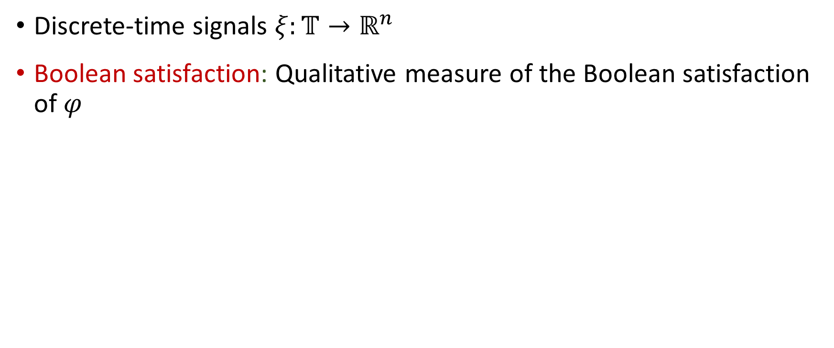
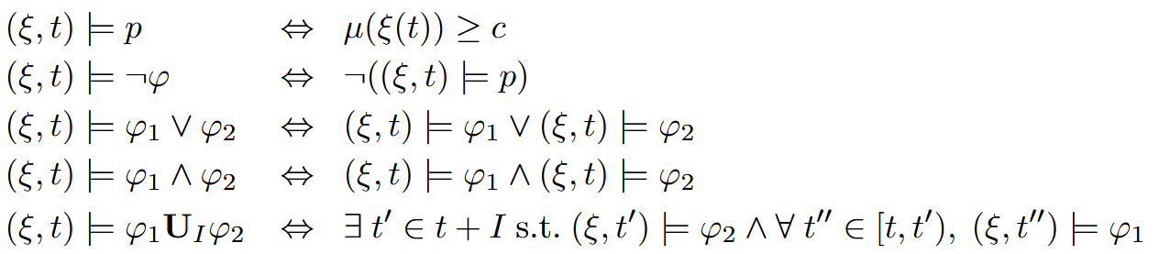
STL Boolean Semantics
Notes:
In our work, we mainly consider discrete-time signals.
STL is equipped with a qualitative Boolean semantics indicating the satisfaction of a signal wrt a property at a given time.
13s

Slide 12
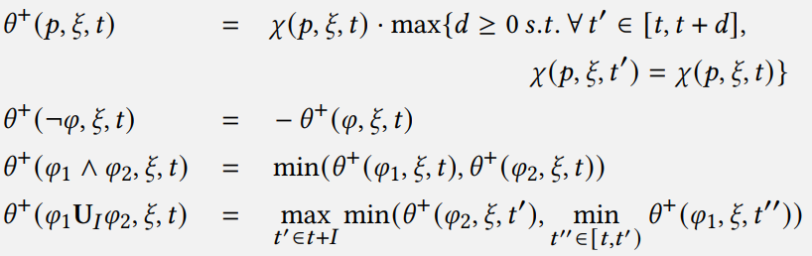
STL Quantitative Semantics
Robustness: Quantifies the extent to which a signal satisfies 𝜑.
Notes:
The space robustness describes how much a signal can be perturbed (/pərˈtərbd/) before affecting the Boolean property satisfaction.
20s

Slide 13
STL Online Monitoring
Real-time evaluation of temporal requirements over streaming signals
Incrementally compute satisfaction or robustness values as partial signal data becomes available
  Early termination, predictive monitoring, runtime enforcement…
Efficient and Robust online monitoring algorithms for STL [Deshmukh17]
Notes:
… enable real-time evaluation of temporal requirements over streaming signals. They incrementally …. for …
People have designed a number of algorithms for efficient and robust online monitoring…

Slide 14
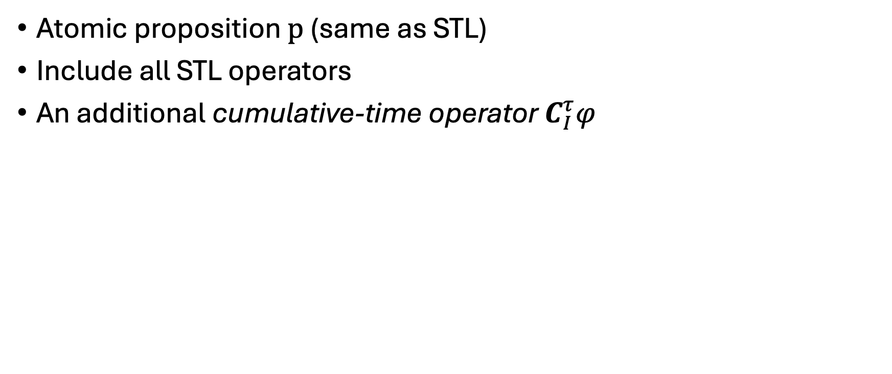
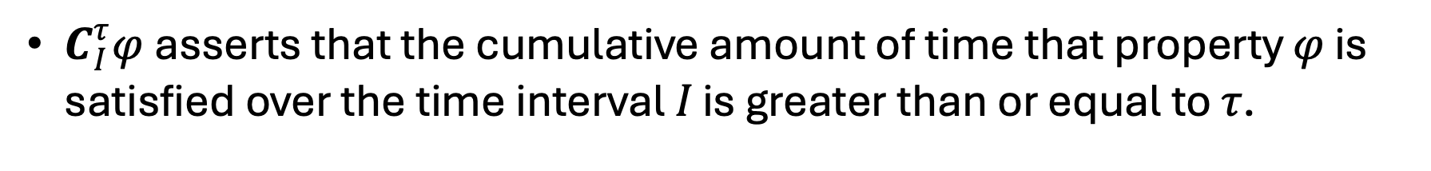
Syntax of Cumulative-time STL (CT-STL)
CT-STL syntax
Notes:
Basically, it is an extension to STL with all STL operators with an additional cumulative-time operator C. So what does it do? The idea is simple. It asserts

Slide 15
Expressiveness of CT-STL
Any STL formula can be expressed in CT-STL
In general, CT-STL is strictly more expressive than STL
In the discrete-time domain, a cumulative-time requirement can be represented as a disjunction over all possible combinations of cases with at most 𝜏 satisfying time points
  an exponential formula size
  Prefer CT-STL for succinctness

Slide 16
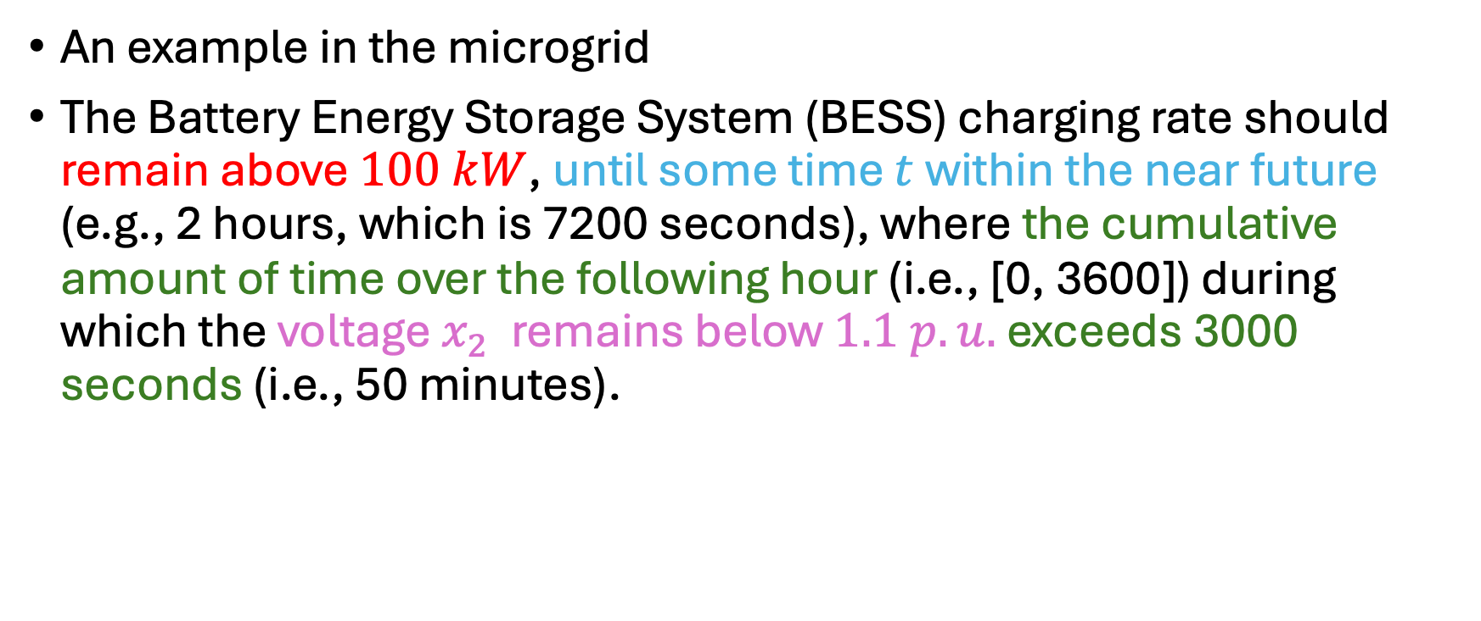
Expressiveness of CT-STL

Slide 17
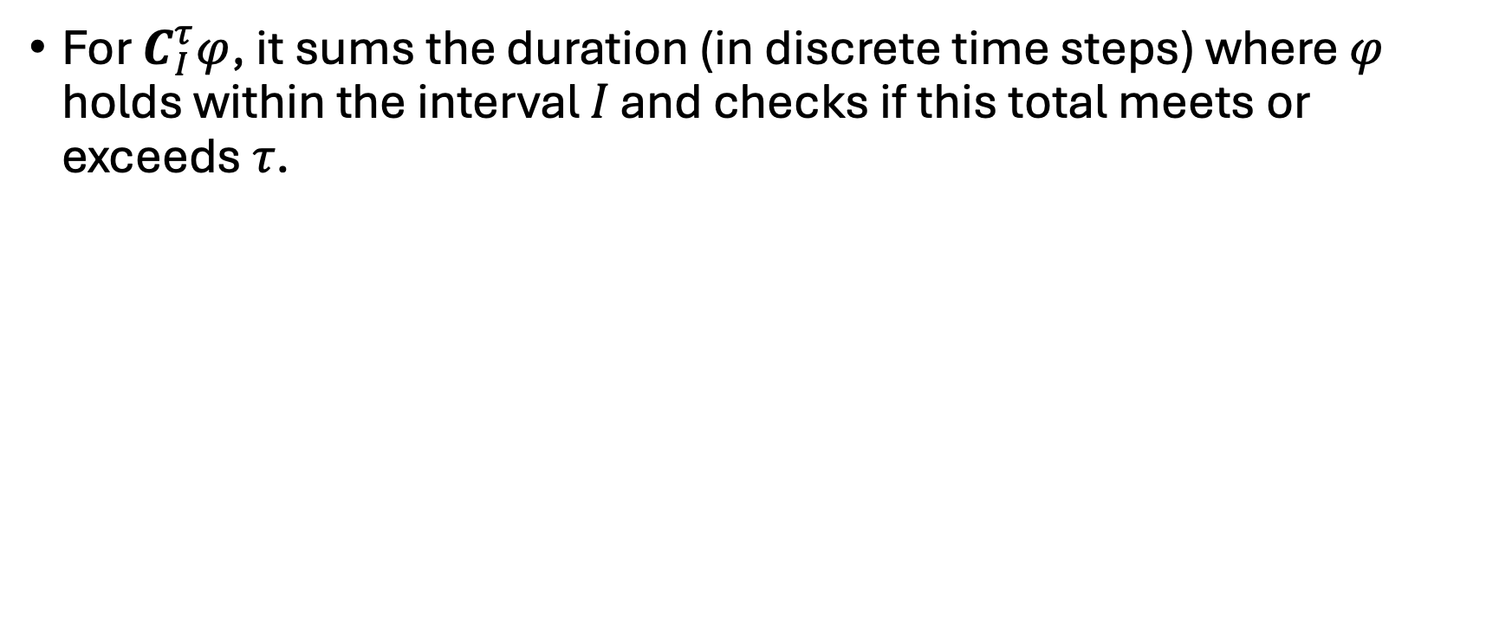

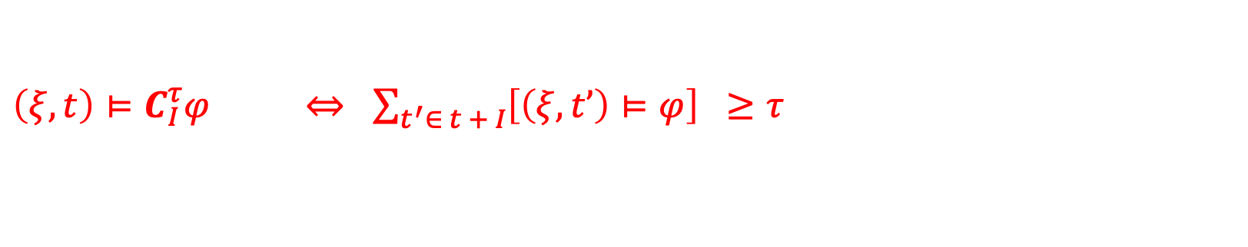
CT-STL Boolean Semantics
Notes:
In our work, we mainly consider discrete-time signals.
STL is equipped with a qualitative Boolean semantics indicating the satisfaction of a signal wrt a property at a given time.
13s

Slide 18
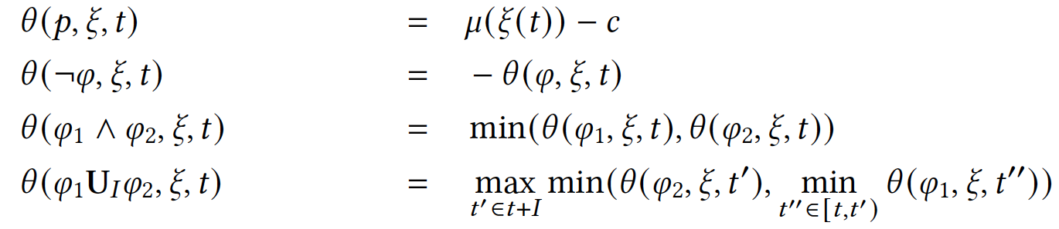
CT-STL Quantitative Semantics
CT-STL robustness quantifies the perturbations allowed to the values of atomic propositions evaluated along a signal such that the Boolean truth value of the CT-STL formula w.r.t. the signal is preserved.
Notes:
For the …., it quantifies the …… So, we adopt this idea of robustness semantics that is consistent to STL.

Slide 19
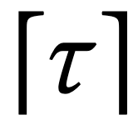
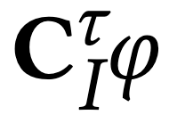
CT-STL Quantitative Semantics
Imagine ranking φ’s robustness values over I from highest to lowest
The -th value is the “weakest link” determining whether the cumulative threshold is robustly met
This ensure the cumulative amount of time for which the robustness value is positive (i.e., property φ is satisfied) is larger than or equal to τ
Therefore, the Boolean truth value of is preserved.
Guarantees that perturbations smaller than the robustness degree |θ(φ,ξ,t)| cannot flip the truth value of φ
Notes:
So why this property still holds for our robustness semantics definition for the cumulative-time operator?

Slide 20
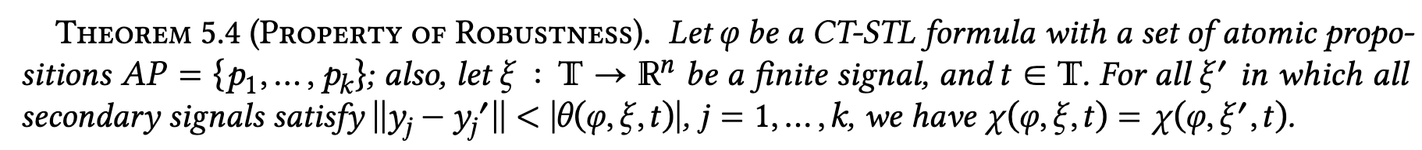
CT-STL Quantitative Semantics
Notes:
So why this property still holds for our robustness semantics definition for the cumulative-time operator?

Slide 21
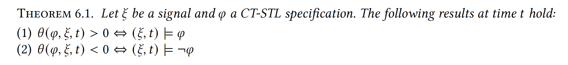
Soundness and Completeness
For cumulative-time operators, robustness positivity ensures the cumulative duration is truly ≥ 𝜏 (no false positives), while negativity guarantees it is < 𝜏 (no false negatives).

Slide 22
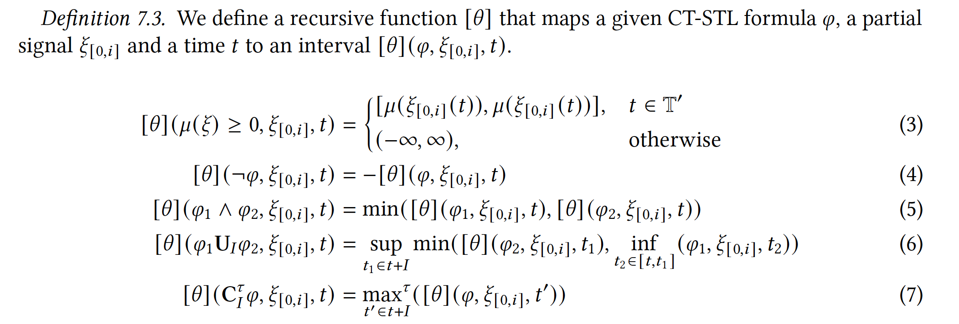
Monitoring CT-STL
We extend an online monitoring method for STL [Deshmukh17] to CT-STL.
It computes the upper and lower bounds (thus, an interval) of the robustness as new data point comes in.

Slide 23
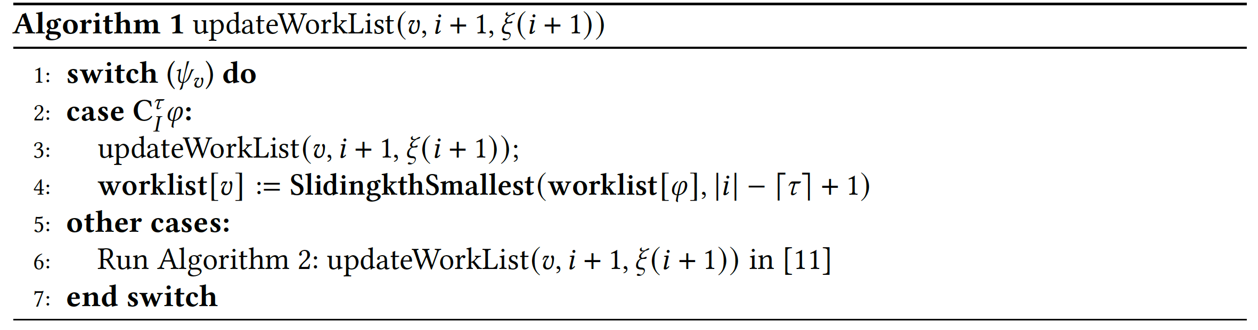
Monitoring CT-STL
We extend an online monitoring method for STL [Deshmukh17] to CT-STL.
It computes the upper and lower bounds (thus, an interval) of the robustness as new data point comes in.

Slide 24
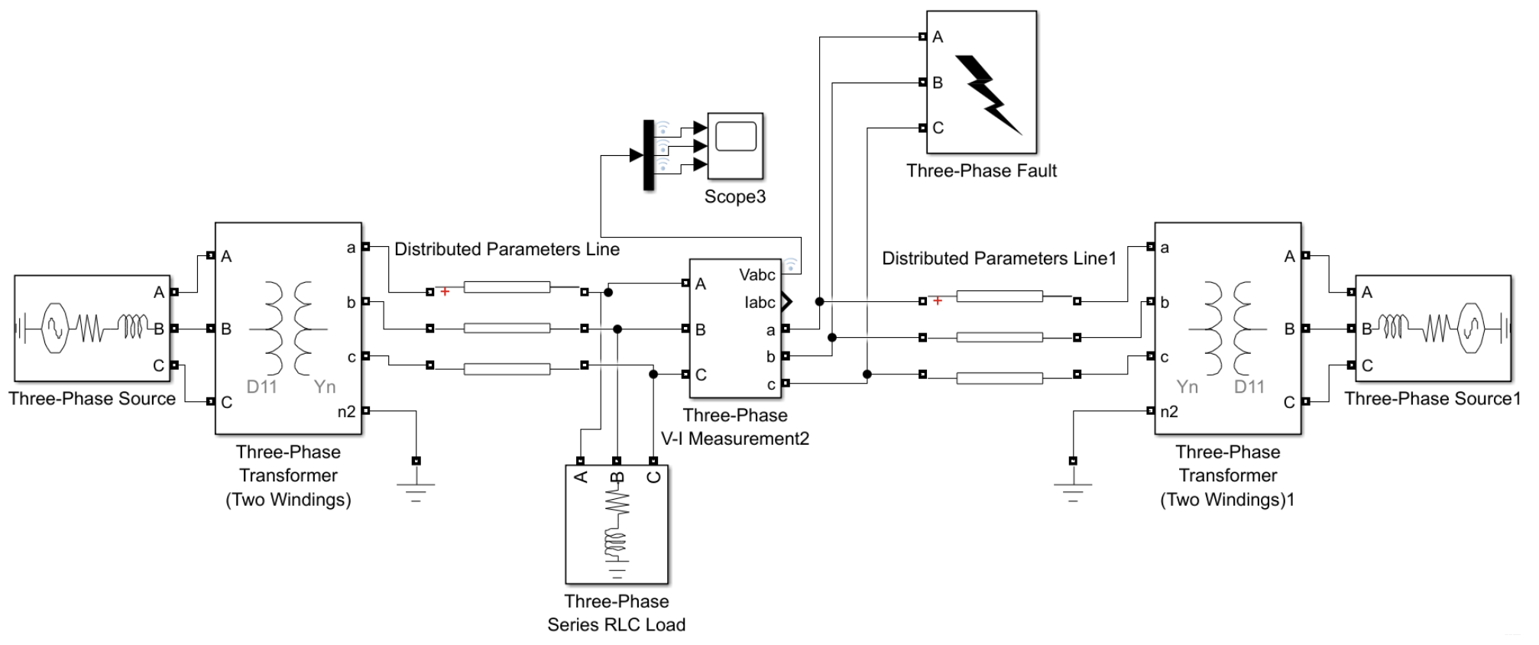
Case Studies: Microgrids

Slide 25
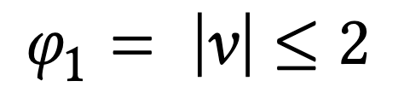
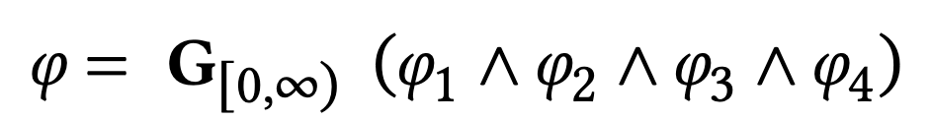
Case Studies: Microgrids
Absolute overvoltages exceeding 2.0 per unit (𝑝.𝑢.) of nominal instantaneous peak base are strictly prohibited.
2. The cumulative duration during which the absolute value of voltage exceeds 1.7 𝑝.𝑢. must not exceed 1.6 ms. Similar cumulative time constraints apply to other threshold levels.
Overall requirement:

Slide 26




Case Studies: Artificial Pancreas
Clinical guidelines recommend
Hypoglycemia Avoidance: percentage time in hypoglycemia is less than 4%.
2. Hyperglycemia Limitation: percentage time in hyperglycemia is less than 25%.
2. Euglycemia Maintenance: percentage time in euglycemia is more than 75%.
Overall requirement:

Slide 27
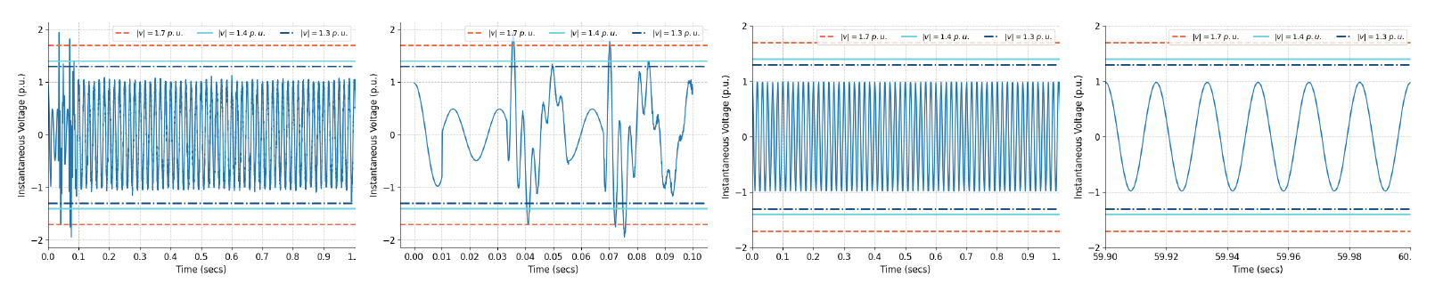
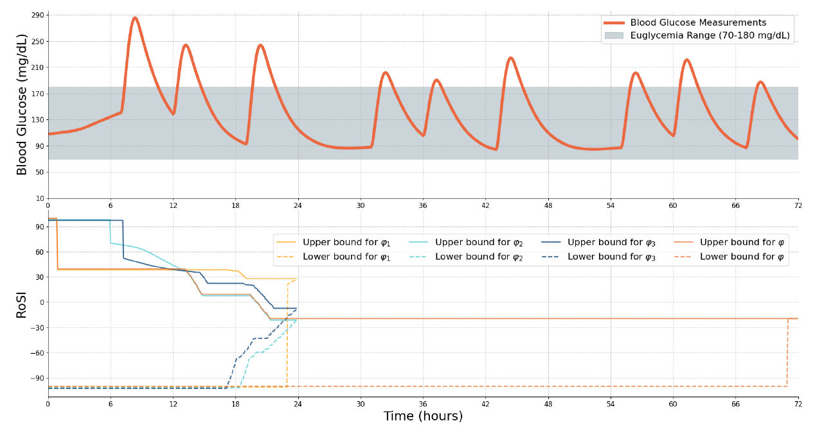
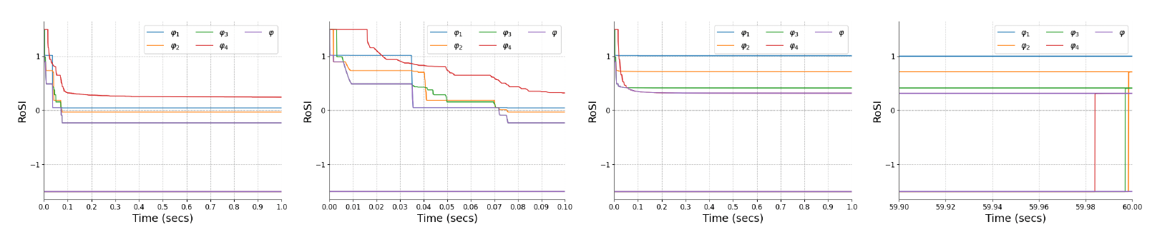
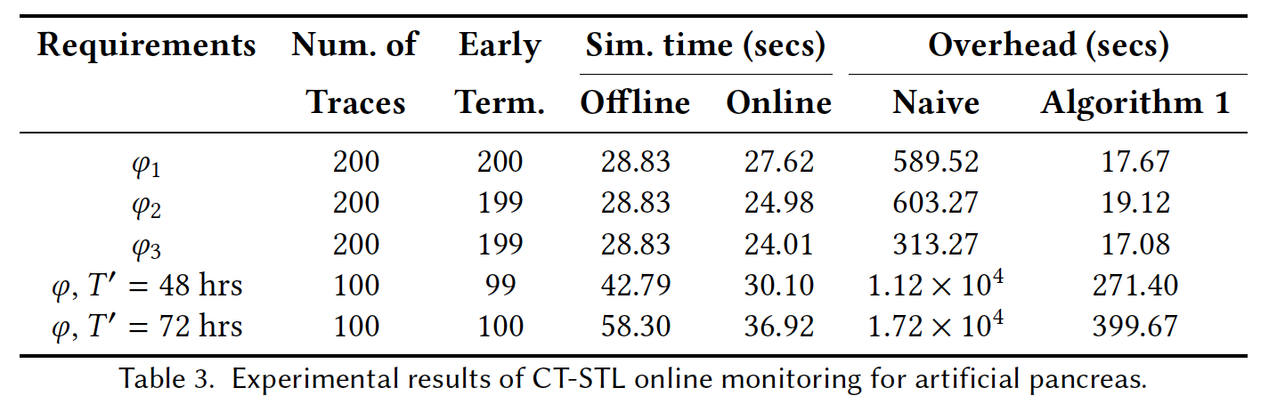
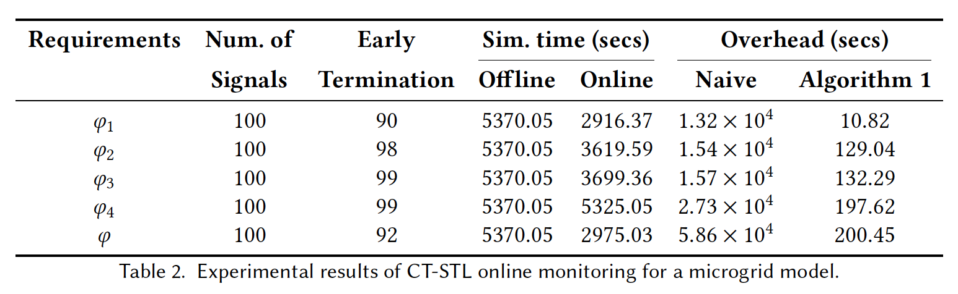
Case Studies: Online Monitoring Alg. Performance
Early termination: ~90%+ of all cases
Total simulation time: reduce up to 46% (microgrid) and 36.7% (artificial pancreas)
Computation overhead: 118-1200x (microgrid) and 18-43x (artificial pancreas) speed up

Slide 28
Conclusions
A new language, CT-STL, that extends STL with a cumulative-time temporal operator.
Consistently extend STL’s original quantitative semantics which is both sound and complete.
Provide an efficient robust online monitoring algorithm for our new logic.

Slide 29
Cumulative-time Signal Temporal Logic
Hongkai Chen
The Department of Information Engineering
¹ The Chinese University of Hong Kong, Hong Kong
For more information, contact
hkchen@ie.cuhk.edu.hk
or visit
https://hongkaichen.cuhkaiot.com/

