Slide 1
VeTrack: Real Time Vehicle Tracking in Uninstrumented Indoor Environments
Mingmin Zhao¹, Tao Ye¹, Ruipeng Gao¹, Fan Ye², Yizhou Wang¹, Guojie Luo¹
EECS School, Peking University, China¹
ECE Dept., Stony Brook University²
ACM SenSys 2015
Seoul, South Korea

Slide 2

Why Real Time Tracking Needed Indoors
Motivation
  Non-GPS environments
    Underground/multi-level parking structures
  Cognitive needs for sense of “control”
  Navigation for smart parking services
  Find the car upon return
Difficulties
  Lack of radio signals (WiFi, cellular)
  No Internet/backup support
  High costs to instrument the environment

Slide 3
Challenges: Inertial and phone-only
Reliable phone pose estimation
  Arbitrary placement/slope surface
  Possibly frequent changes due to human/road disturbances
Reliable landmark detection
  Landmarks (e.g., speed bumps, turns) to calibrate locations
  Distinguishing from hand movements
Balance between tracking accuracy vs. latency
  Delayed location decision improves accuracy but increases latency
Notes:
Inspirations
3D->1D
Probabilistic framework with possible calibration
Different parking structures/vehicles/drivers

Slide 4
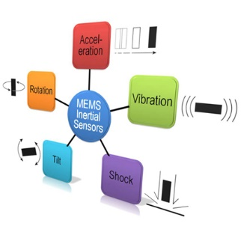
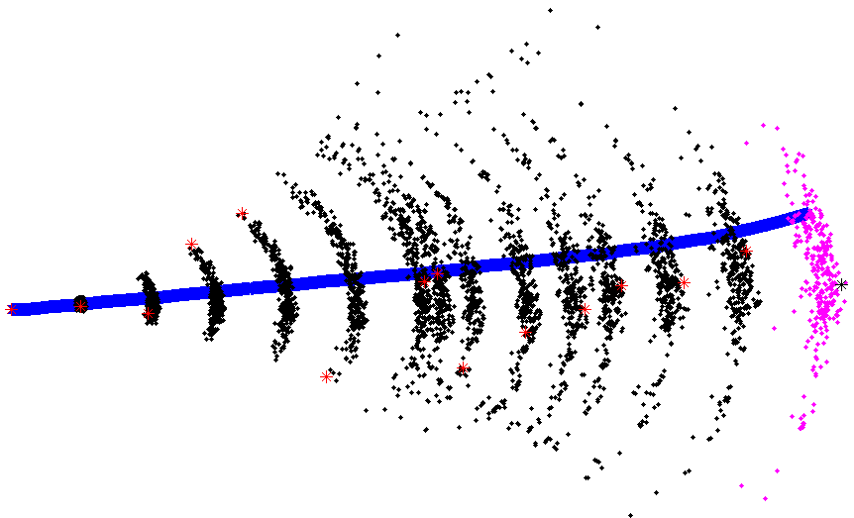
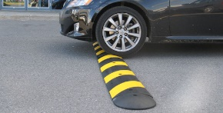
  VeTrack overview
Overview
  3D→2D pose: “Shadow trajectory” tracing
  Tracking: Sequential Monte Carlo framework + road skeleton model
  Calibration: landmark detection
Inertial data
3D → 2D
Sequential Monte Carlo
Floor map
2D → 1D
Landmark detection

Slide 5
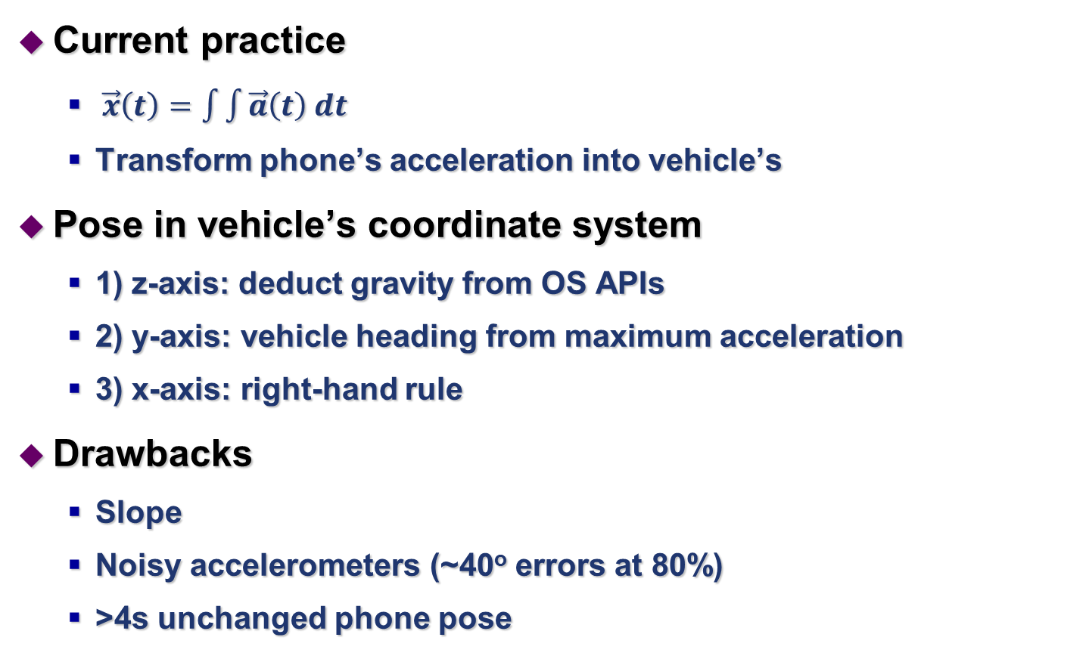
Existing 3D trajectory tracing
Current practice
  $\vec{x}\left(t\right)=\int{\int{\vec{a}\left(t\right) dt}}$
  Transform phone’s acceleration into vehicle’s
Pose in vehicle’s coordinate system
  1) z-axis: deduct gravity from OS APIs
  2) y-axis: vehicle heading from maximum acceleration
  3) x-axis: right-hand rule
Drawbacks
  Slope
  Noisy accelerometers (~40º errors at 80%)
  >4s unchanged phone pose

Slide 6
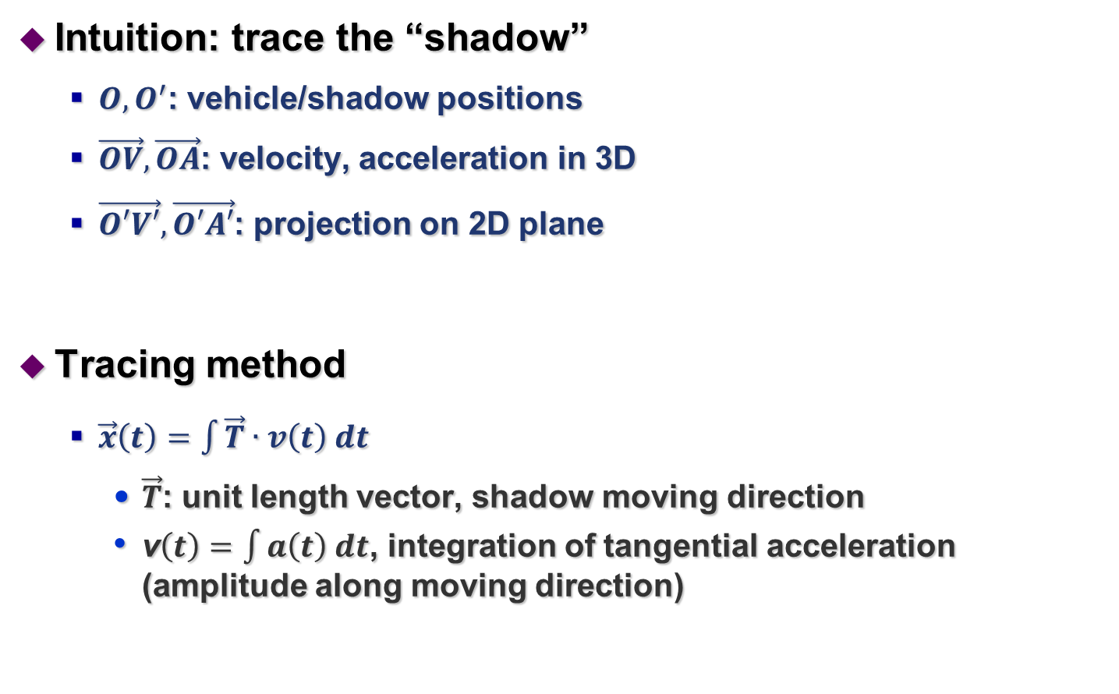
Our 2D Shadow Trajectory Tracing
Intuition: trace the “shadow”
  $O,O^{′}$: vehicle/shadow positions
  $\vec{OV},\vec{OA}$: velocity, acceleration in 3D
  $\vec{O′V′},\vec{O′A′}$: projection on 2D plane
Tracing method
  $\vec{x}\left(t\right)=\int{\vec{T}∙v\left(t\right) dt}$
    $\vec{T}$: unit length vector, shadow moving direction
    v$\left(t\right)=\int{a\left(t\right) dt}$, integration of tangential acceleration (amplitude along moving direction)
O
Notes:
from gyroscope and maps
Eliminate vertical direction noises
$\vec{T}$ estimation reliable from map and gyroscope

Slide 7

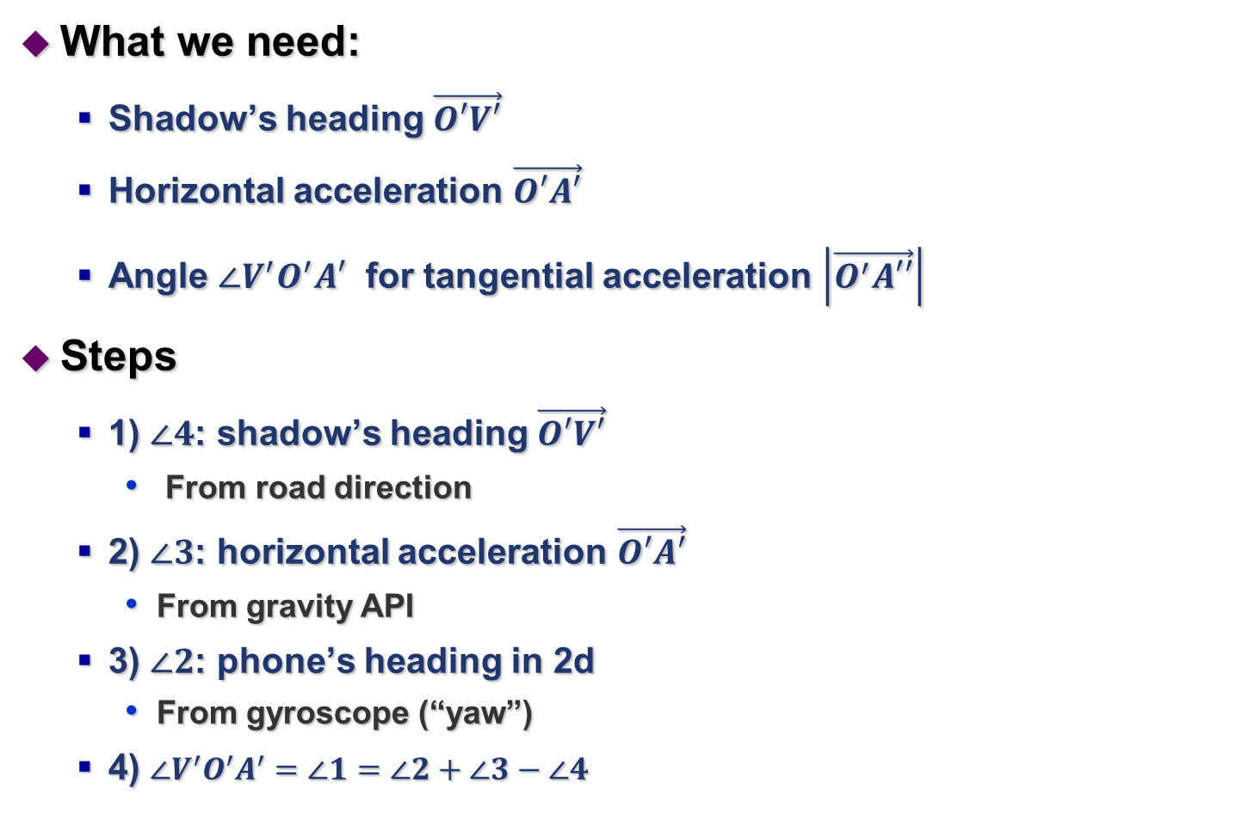
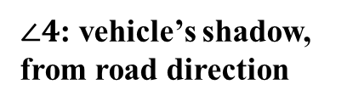
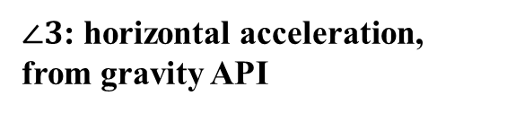
Computing Shadow Trajectory
What we need:
  Shadow’s heading $\vec{O′V′}$
  Horizontal acceleration $\vec{O′A′}$
  Angle $∠V^{′}O^{′}A′$ for tangential acceleration $\left|\vec{O^{′}A′′}\right|$
Steps
  1) $∠4$: shadow’s heading $\vec{O′V′}$
    From road direction
  2) $∠3$: horizontal acceleration $\vec{O′A′}$
    From gravity API
  3) $∠2$: phone’s heading in 2d
    From gyroscope (“yaw”)
  4) $∠V^{′}O^{′}A^{′}=∠1=∠2+∠3−∠4$
$∠2$: phone’s heading, from “yaw”
$∠4$: vehicle’s shadow, from road direction
$∠3$: horizontal acceleration,
from gravity API

Slide 8
Advantages of Shadow Tracing
Advantages
  1) eliminate variables in vertical dimension
    Altitude, angle, speed and acceleration
    Noises, complexity
  2) accurate vehicle’s shadow direction
    Obtained from the road direction
    Eliminate inertial noises perpendicular to moving direction
  3) use gyroscope to estimate pose
    Much more robust than accelerometers
Effects
  Handle arbitrary phone and vehicle poses, e.g., slopes
  5~10º errors at 80-percentile
  Instantaneous pose estimation

Slide 9
Real time tracking
Intuition: combine map and landmark constraints
  Road skeleton model

Slide 10
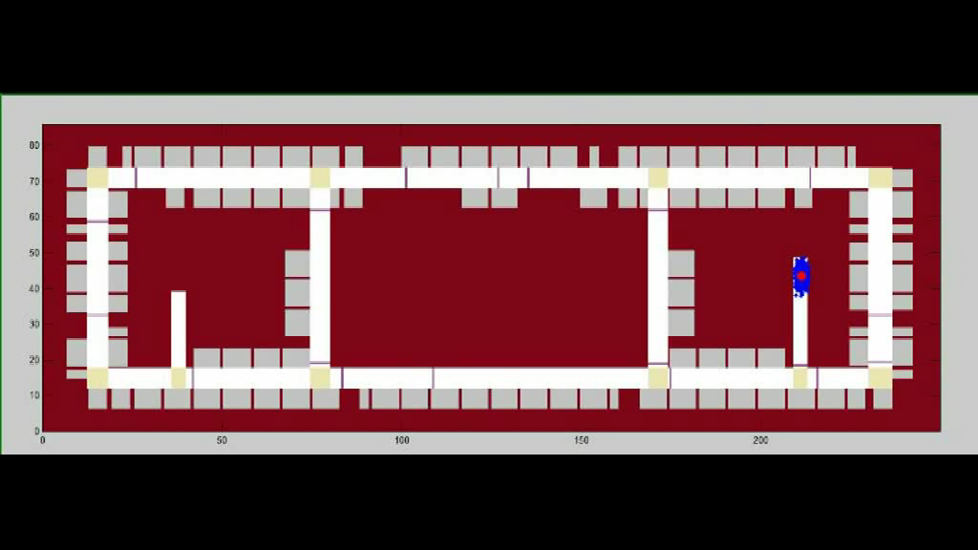
Probabilistic Tracking Framework
Sequential Monte Carlo (SMC) method
  1) state update (x,y,v,α, β)
    Predict the states of the next time slot
  2) weight update
    Compute the “likelihood” based on landmark and map constraints
  3) resampling

Slide 11
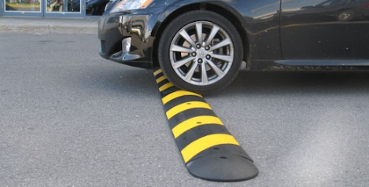
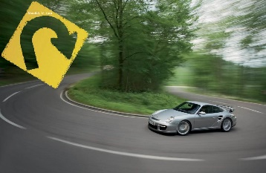
Landmark detection
Landmarks in parking structures
  Speed bumps, turns
  Vehicle location calibration
Reliable and real time detection is non-trivial
  Road conditions
  Hand movements
  Delay

Slide 12
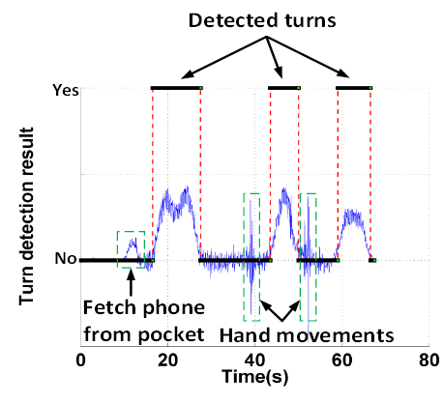
Ambiguities in Landmark Detection
Bumps
  Acceleration in the Z-axis
    Starting tremors (J)
    Hand movement (M)
Turns
  Duration of continuous direction changes
  Detected from phone’s heading (“yaw”)
    Human disturbances

Slide 13
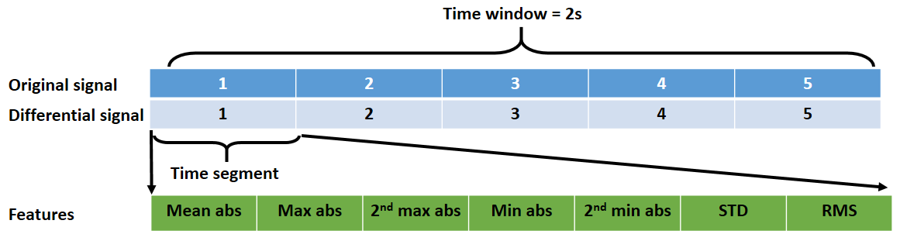
Bump/Turn detection
Feature sets
  (1) STAT35
    35 dimensions
  (2) DSTAT35
    70 dimensions
  (3) FFT5: first five harmonics
    5 dimensions
  (4) S7FFT5: FFT5 + two half-size, four quarter-size signals
    35 dimensions
  (5) DFFT5: FFT5 + differential signals
    10 dimensions
Classification
  Logistic Regression (LR), Support Vector Machine (SVM)

Slide 14

Avoid detection latency
Prediction and rollback
  Signals before/after landmark needed for accuracy
  Our intuition: landmarks are rare events
Display, latency=T
No landmark
Display
Display,
Latency<0.2s
Bump!
Rollback
2T
T
T

Slide 15
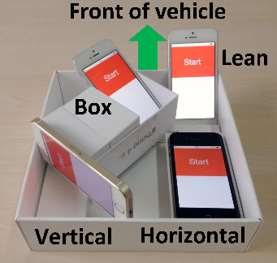
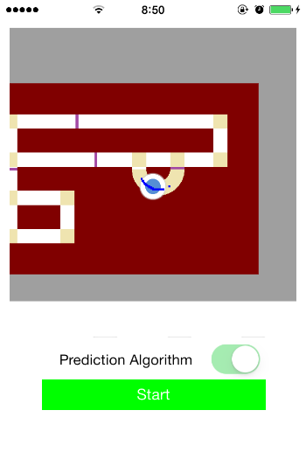
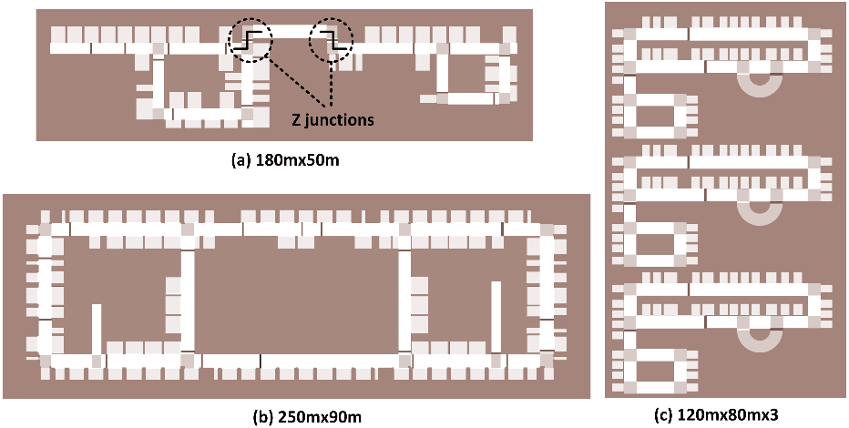
Performance evaluation
Methodology
  iPhone 4/4s/5/5s/6
  3 underground parking lots
  20 trajectories for each chosen parking spot
  8 poses for common driving scenarios
    A mould to hold 4 iPhones with 4 poses
    One in driver's pocket
    One in a bag on a seat
    Two held in hands with movements
  Use video for real time ground truth

Slide 16
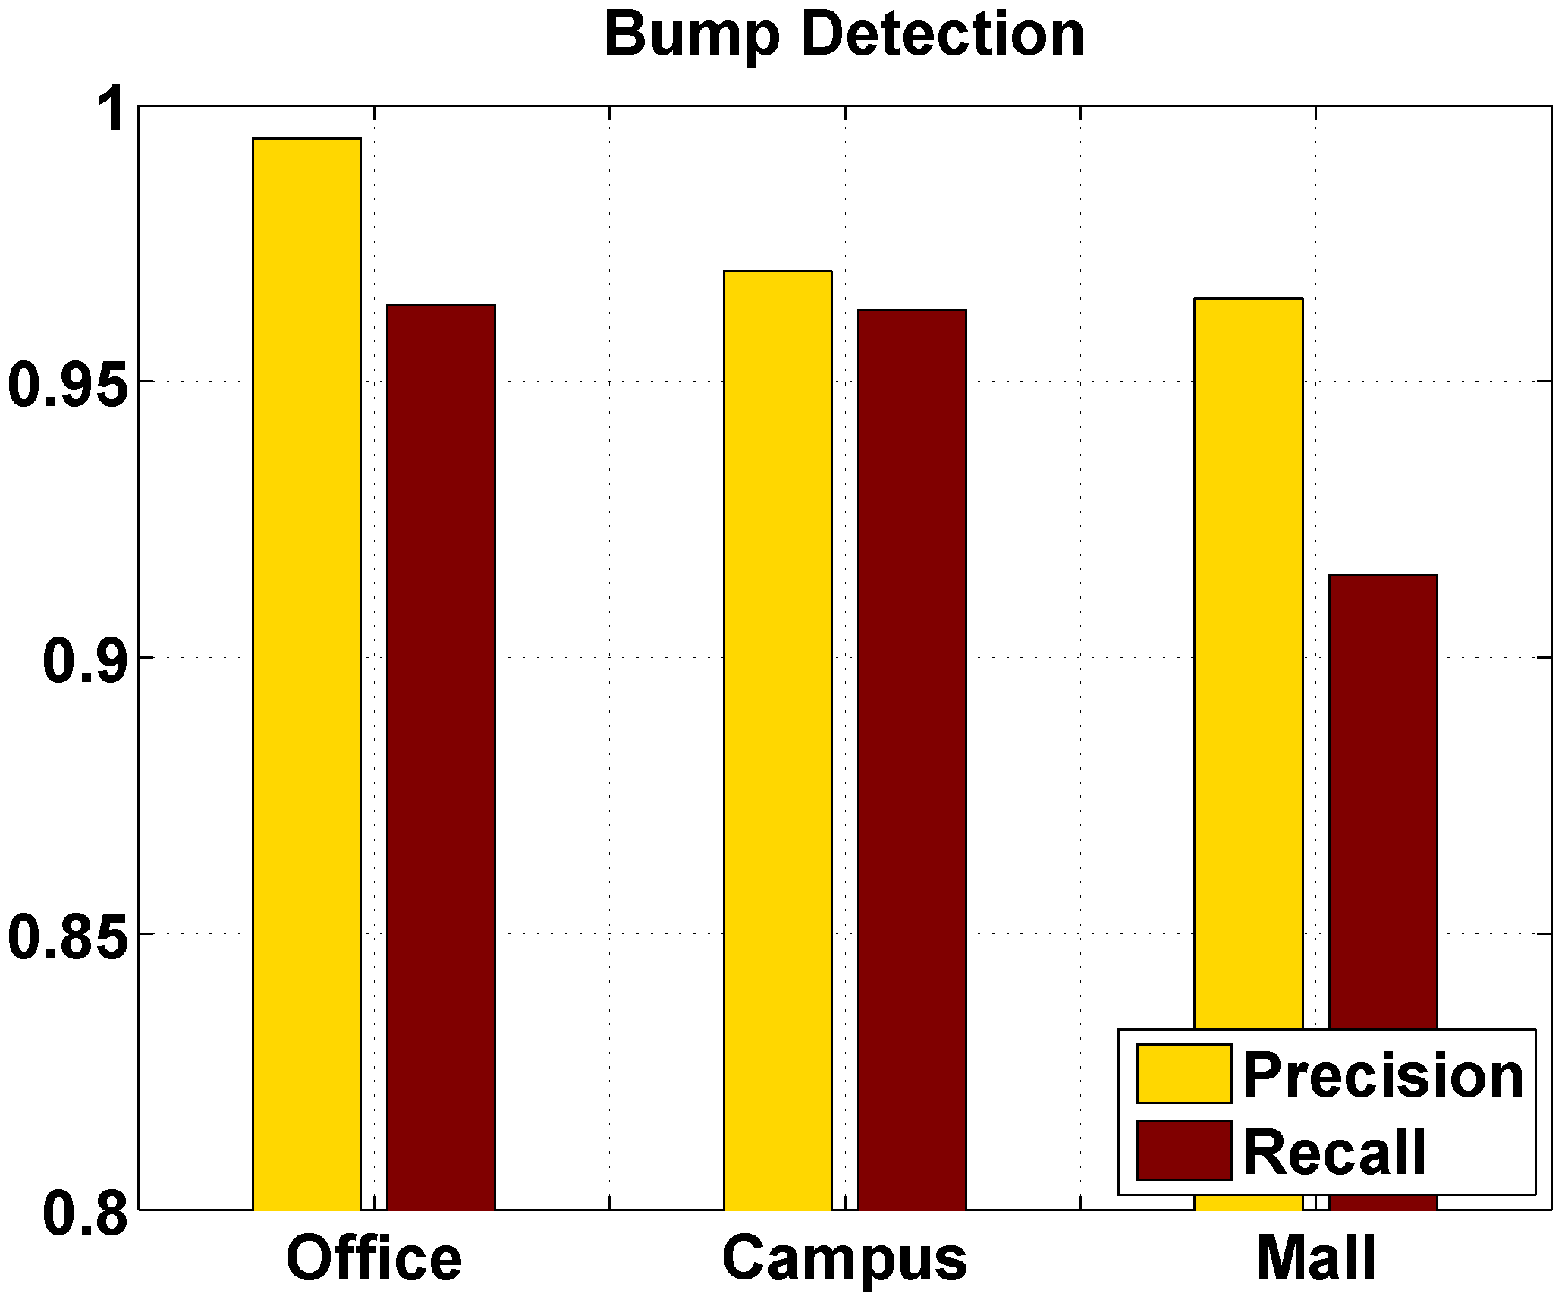
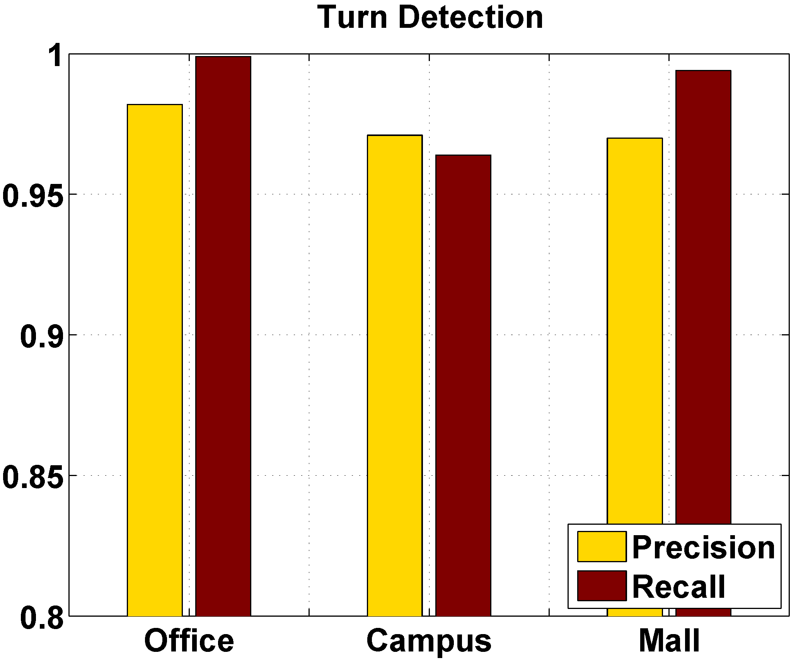
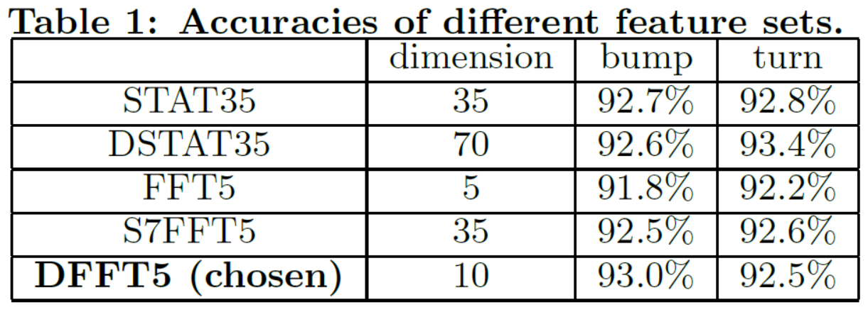
Performance evaluation
Landmark detection
  Feature sets
    DFFT5: ~93% accuracy, low complexity
  Precision & recall
    Bump: ~ 91%; Turn: ~ 96%
    Mould > pocket/bag >hand

Slide 17
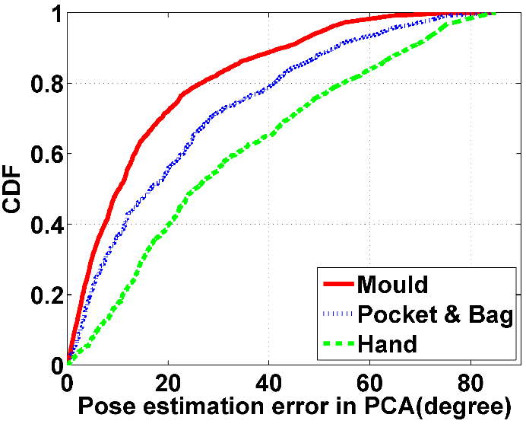
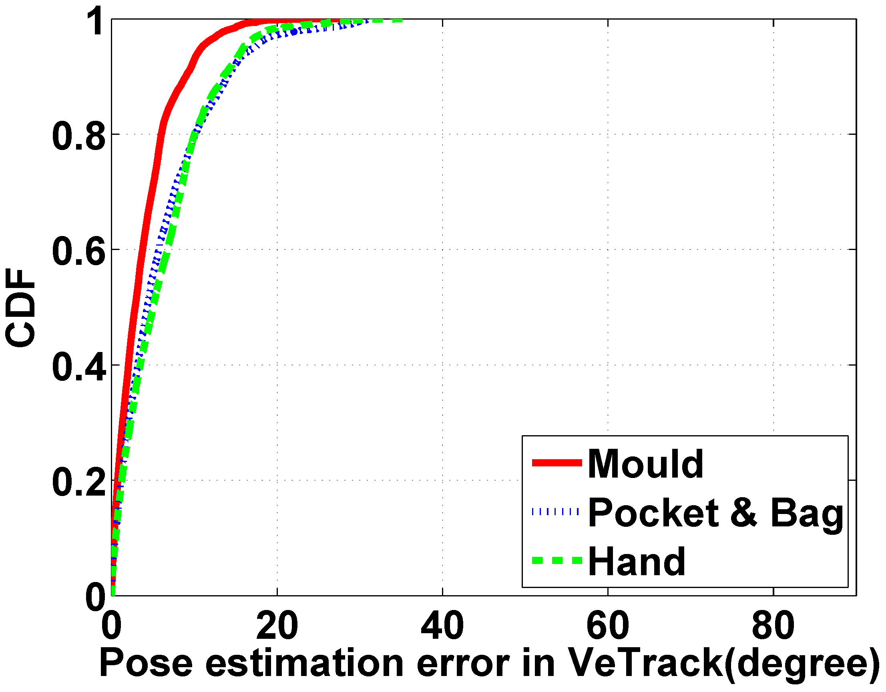
Performance evaluation
Phone pose estimation
  3D method: PCA, 50-70º (90%), 4s window
  2D: shadow tracing, 10-15º (90%), instantaneous

Slide 18
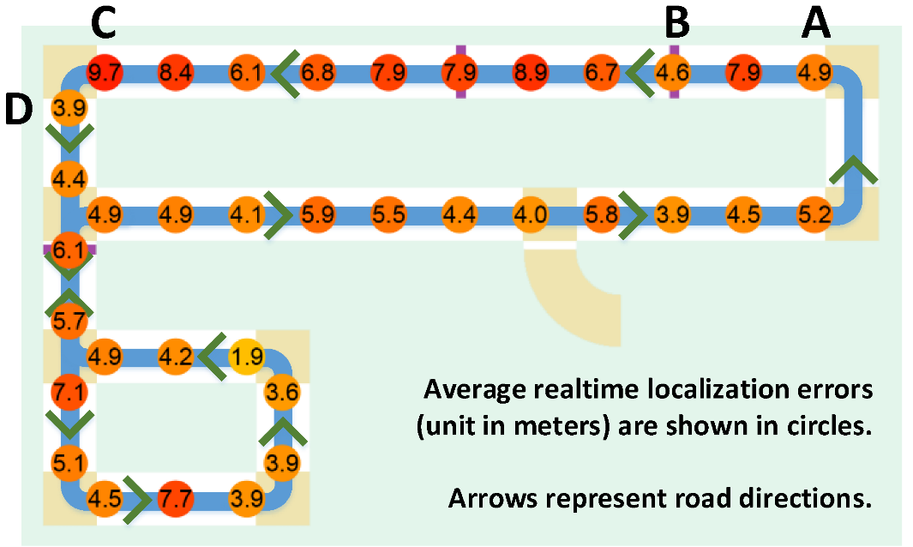
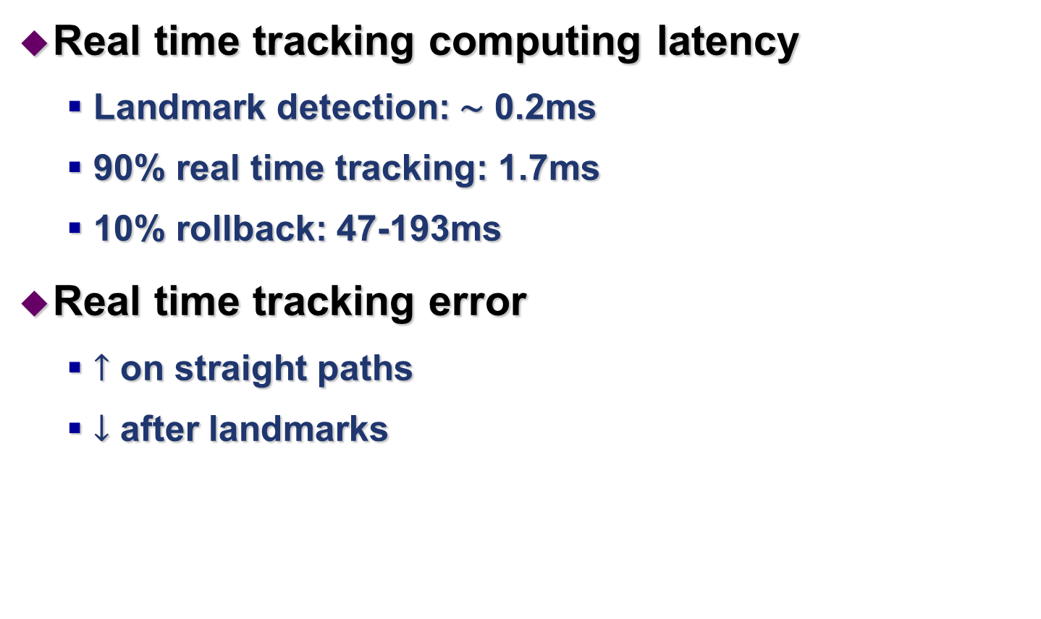
Performance evaluation
Real time tracking computing latency
  Landmark detection: ∼ 0.2ms
  90% real time tracking: 1.7ms
  10% rollback: 47-193ms
Real time tracking error
  $↑$ on straight paths
  $↓$ after landmarks

Slide 19
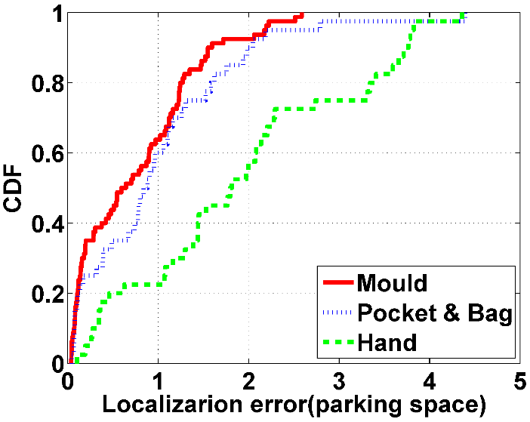
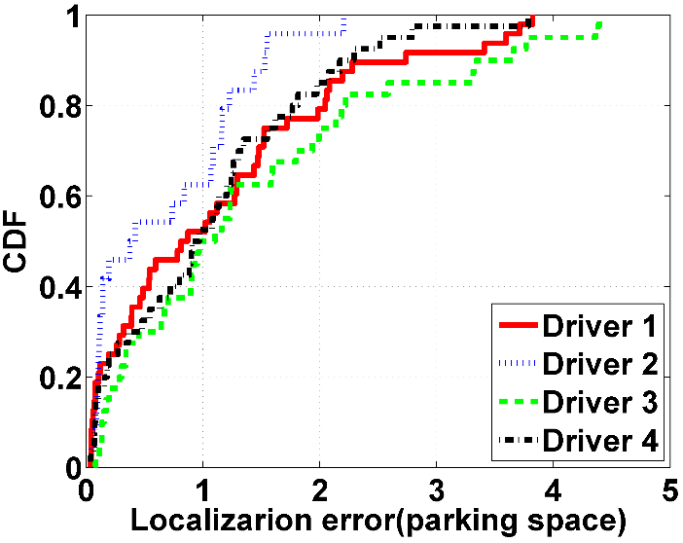
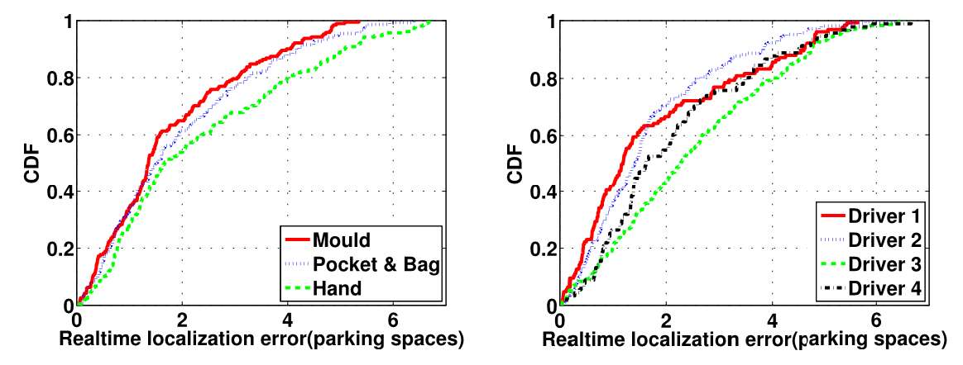
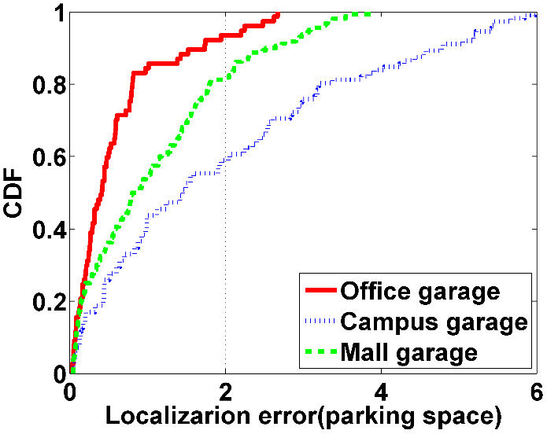
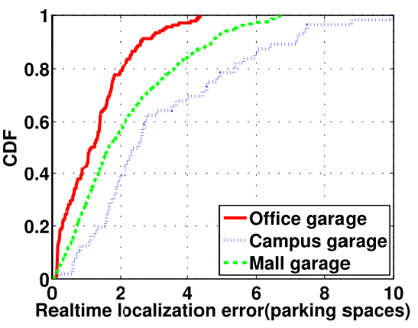
Performance evaluation
Parking/Tracking location errors
  Metric: number of parking spaces
  8 poses: 90%~2-4, max~3-5 parking space errors
    Mould < bag/pocket < hand
  Reasonable accuracy across 4 drivers, 3 garages

Slide 20
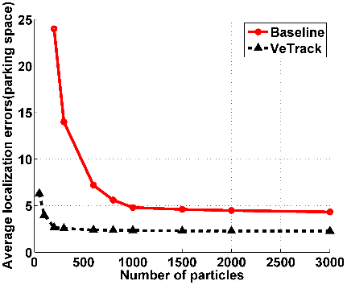
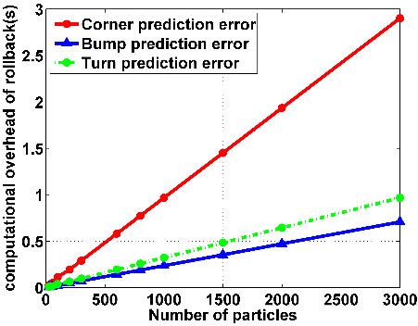
Performance evaluation
Optimal number of particles
  Balance between tracking accuracy and rollback latency
  200 particles: 2.5 parking spaces error, 0.2s latency

Slide 21
Related work
Phone pose estimation
  PCA: not for slopes or frequent pose changes
Robotics
  SLAM: unknown maps, high quality data
Dead-reckoning
  high precision displacement sensors (e.g., odometry)
  Fast error accumulation by commodity devices
Notes:
Estimation of vehicle states
Compute the speed using GPS/RF signal outdoors

Slide 22
Summary
VeTrack: track a vehicle’s location in real time
  Inertial data only, computing locally on the phone
  Phone pose
    Shadow trajectory tracing
  Probabilistic framework
    Constraints from landmarks and garage maps
    Skeleton road model
  Landmark detection
    Prediction and rollback

Slide 23
Thank you!
Questions?

Slide 24
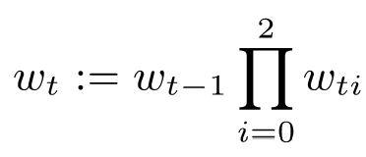



Backup
Particle states:
  Level index;
  Position on 2D floor plan;
  Speed of vehicle;
  Phone/vehicle shadow’s 2D heading direction
Weight update
  Constraints imposed by the map
    Penalize particles that have a drastic change in vehicle heading direction
  Detected landmarks
    Penalizes the predicted states far away from detected landmarks

Slide 25
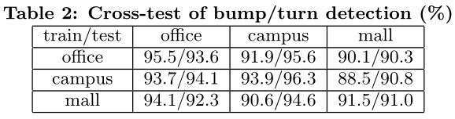
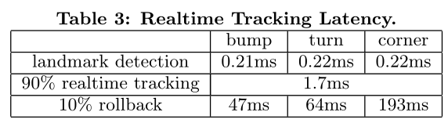
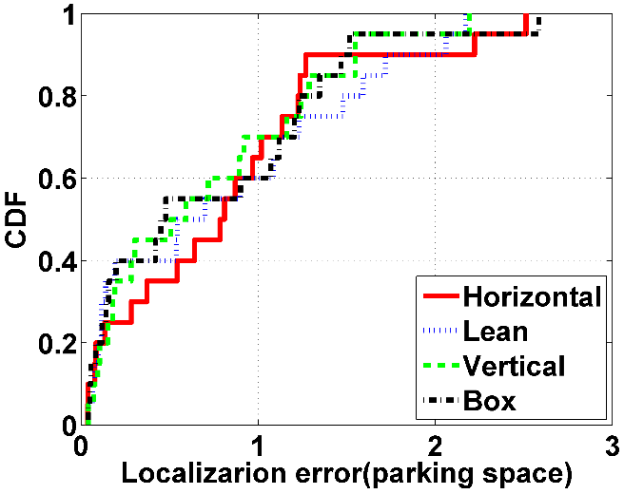
Backup
Cross-test of landmark detection
Real time tracking latency
Different poses in the mould

Slide 26
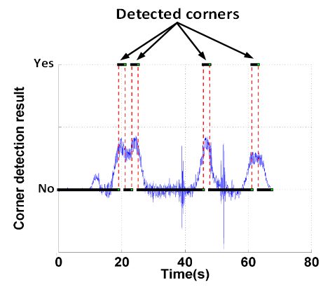
Ambiguities in Landmark Detection
Corners
  Consecutive turns
  Local maxima

